Slide 1
Discovery-driven design in social games: techniques, processes, and problems
Heather Stark
Kinran
Strata Conference
London
October 1 2012
Notes:
Hi, I’m talking about analytics in game development, what’s going on, and what’s wrong. I’m going to be putting these slides up on slideshare so don’t worry if you miss a bit of detail. Comment on twitter if you like – I’m HAStark.

Slide 2

Market dynamics
Service access, delivery, and pricing
Notes:
Here’s a bit of context. Computer games market have seen this huge upheaval recently, in access, delivery, and pricing. And the revolution is this (change slide)

Slide 3
Market dynamics
Service access, delivery, and pricing
Notes:
The physical packaged thing - is pretty much disappearing as the unit of retail distribution.

Slide 4


Social, mobile, and ‘free’
F2P
+
+
Notes:
Instead, people are accessing computer games online, through browsers and smartphones, and via social networks, particularly Facebook. And, overwhelmingly, they aren’t paying for access. Games publishers make money by selling in-game privileges. Along with this has come a shift in the type of game that are played, and the demographic of the gamer. The game characters don’t all look like Conan the Barbarian any more. I am not saying the new wave of games is better – but it’s different.

Slide 5

“The biggest gold rush in the history of games” – Venturebeat
Notes:
Anytime there’s a market disruption there’s an opportunity. The Facebook games market leader, Zynga, went from nowhere to $1bn in annualised revenue. And that got investor’s attention.

Slide 6
$3.75 billion
http://venturebeat.com/2012/01/06/deanbeat-game-companies-raised-a-record-breaking-1-55b-in-2011/
Notes:
Including IPO proceeds, almost $4bn rushed into the sector last year.

Slide 7
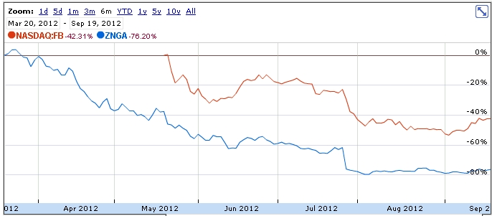

But.....
IPO
Zynga
Facebook
IPO
-40%
-76%
http://www.google.com/finance?cid=481720736332929, Sept 19 2012
Notes:
A bit of the pixie dust has worn off, as you can see. Part of this is irrational exuberance letting off steam, but part of it is due to a market shift.

Slide 8
Social [vs, plus] mobile
A lot of the development and the energy in the eco-system is not going towards building desktop stuff anymore, it's going towards building mobile stuff
Mark Zuckerberg
Sept 11 2012
http://www.reuters.com/article/video/idUSBRE88A1F220120912?videoId=237677561
...in July, Facebook sent people to the Apple App Store and Google play more than 170 million times...
https://developers.facebook.com/blog/post/2012/09/14/facebook---gdc-europe--developer-day-recap/
Notes:
There’s a bunch of a shin-kicking exercise going on under the desk between social and mobile. You might say on Facebook that the relationship status is: it’s complicated. Like Zuckerberg says, momentum has shifted to native mobile devices.

Slide 9
Has the world ended?
Facebook
  nearly 1 bn Facebook users
  25% play games regularly
  virtual goods spend on FB estimated at $1.2 billion 2011
iOS and Android
  games revenue 2011 = 2x traditional portable console (reverse of 2009)
  in-app purchases 87% of revenue of top 25 grossing apps
  total worldwide game revenue $1.6 bn 2011
  68% of sessions from ‘indie’ developers (i.e. new market entrants)
Sources: Facebook, Flurry, InsideNetworks
Notes:
No, and Facebook hasn’t disappeared either. 250 m people a month play games via the FB platform.

Slide 10
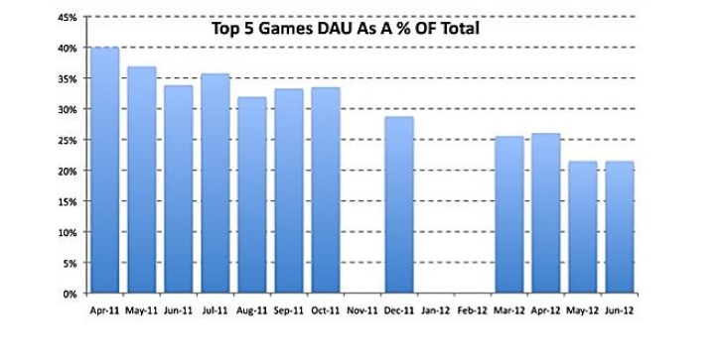
Market concentration has changed
Source: Velo Partners aggregation of AppData data
http://www.slideshare.net/evanvrs/end-of-the-bull-market
Notes:
Have things changed? Yes. Leaders have less of a share of the total market.

Slide 11
Analytics
is everywhere
Notes:
So – that’s the market context. Volatile, high-growth, risky. And powered by analytics. Zynga’s CEO has got a good quote “Zynga is really an analytics company masquerading as a games company”. They had 10 people onboard before they hired a designer.

Slide 12




Everyone’s doing it
Playfish
Playfish
Development really starts with launch
hired Ocado
analytics lead
after exec search
King.com
Analytical creativity
extends the product lifecycle
10-15% of staff on
analytics
one release every day
more daily transactions than the FTSE
IsCool
(formerly WEKA)
http://www.gamesbrief.com/2010/04/playfishs-advice-for-building-social-games-development-really-starts-with-launch/ Philip Reiseberger, Chief Games Officer, BigPoint, Evolve in London conference December 2011
http://www.renovatapartners.com/news/kingcom-appoints-director-bi
http://www.facebookgarage.org.uk/talk/big-games-vs-big-data
http://www.slideshare.net/IsCoolEnt/iscool-entertainment-big-data-paris
Notes:
It’s not just a Zynga thing. European firms now make up half the top 10 on Facebook. And, for most, using analytics in some way is a given.

Slide 13
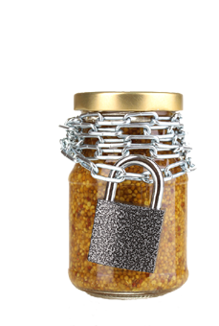
Doing what?
Notes:
It’s secret sauce. I can’t tell you any more. Ok, you can go now. But here’s a serious point - there is no text book. You can take game design courses but this now-fundamental aspect of game development isn’t on the curriculum. You have to make it up. Mostly. But people talk, and they publish on slideshare. And staff go from company to company. And you can look at the lineage from the big American global internet services, Amazon, Google, and Facebook. And you can see what’s on offer from tools designed to provide an easy on-ramp.

Slide 14
Why?
Design = Change
Notes:
What’s fundamental is how the change in distribution enables this massive flow of feedback, and a new approach to product. ‘The product’, like the CD, has disappeared. There is no game, just as there is no Facebook, no Amazon, no Google. What the game is, changes daily. What the game is, changes depends who is looking at it.

Slide 15
Processes
How?

Slide 16
Capturing ‘everything’
Notes:
Here are some things people do – they log user and system events (in context), provide standard reports with some exploratory query based on pre-existing categorisations, they monitor the live game system state, and they investigate patterns and dependencies.

Slide 17
While testing concurrent versions
http://www-conf.slac.stanford.edu/xldb2012/talks/xldb2012_wed_1125_DanielMccaffrey.pdf
We do hundreds and hundred of experiments every quarter.
Lots of experiments...
~3-5K active at any time...
Daniel McCaffrey, General Manager, Platform and Analytics Engineering
2012
Many
fail.
Ken Rudin,
General Manager,
Analytics
2010
Most fail.
http://tdwi.org/videos/2010/08/actionable-analytics-at-zynga-leveraging-big-data-to-make-online-games-more-fun-and-social.aspx
Notes:
And they do this while testing concurrent versions of their system. Sometimes in extreme ways – Zynga has about 3-5 thousand experiments running at the same time. Not everyone goes this far but everyone does something. Even if it’s only split testing their marketing.
I don’t mean to pick on Zynga but they are very mouthy and quotable. And if you’re interested in their tech stack the SLAC presentation has the latest goodies in it.

Slide 18
And.... adapting the design
Any design
element...
Superficial
(almost)
any design
element
Fundamental
And... adapting the design variations
Notes:
There’s different ways of reacting: uh oh, ooh yipee, and ok, next please. Some planned changes are no brainers such as adopting the more successful option that’s been testing, but there are more subtle things at work too, like choosing the timing of new feature introduction. Automated value variation is not the norm, although it’s an idea that some people find exciting. And at the same time as the design is being adapted, the design variations that are being evaluated are also adapted. So you can see it’s a fairly complicated process.

Slide 19
(this slide intentionally left blank)
Notes:
which is why I’ve given you a break here for a little bit

Slide 20
Basic metrics: BI (with a bit of UX)
BI
Acquisition cost
(service delivery costs)
Customer lifetime value
UX
Funnel tracking
Cohort segmentation
Engagement
Monetisation
Retention
Notes:
A lot of attention is focussed on BI, looking at financial I/O, and yield projections offsetting acquisition costs against projected LTV, for different acquisition strategies.
There’s also a set of standard measurements looking at how people traverse defined paths within the application, and how people who joined at particular times are behaving.
Everyone does both of these to some extent – some people take it further than others.

Slide 21
Some popular metrics are bad
Facebook resell per app summary data about DAU and MAU, and leaderboard info is widely freely available
people think DAU/MAU is about retention and engagement
but... it ain’t
What is the right metric for ‘engagement’?
Which is the ‘better’ pattern?
Notes:
DAU/MAU is popular as a measure of engagement and retention – as it’s freely available - but it is flawed. Engagement is something that everyone wants, but which is the better pattern? The answer is: it depends.

Slide 22
No KPI is good but thinking makes it so
Retention
Engage-
ment
Monetis-ation
Virality
Customer
acquisition
cost
LTCV
Notes:
And this is really where analytics comes in. Not only: what is the best measure of engagement, but how does engagement, whatever it is, relate to other KPI’s of interest. There’s a lot of folklore and rules of thumb passed around.

Slide 23
Virality, retention, and value
Retention
Play after day 1?
No
Yes
Recruited by friend
Other
Value
10% of inviters responsible for 50%
of successful invitations
Diffusion dynamics of games on online social networks, Wei, Yang, Adamic, de Araújo and Rehki
http://www-personal.umich.edu/~ladamic/papers/FBgames/FBgameDiffusion.pdf
Notes:
These relationships are interesting. Often, players who are recruited by friends are more valuable. Similarly, some players are valuable because they recruit.
Your mileage may differ. You don’t know ‘til you look.

Slide 24
Analytics
Context
is about discovering these relationships
Out-comes
Experience
types
K
P
I
Actions
LTCV
Player
types
Options
Notes:
The reason people do analytics on game data is to try to pull focus, and discover the relationships between these elements.

Slide 25
Context is complex
Sequential
Filter
goal
loss
Concurrent
Factual
risk
Imputed
action or
event
unease momentum suspense
resource level friend present
loss
choice
reward
Notes:
One thing that’s “interesting” – in scare quotes - is context. Ask me offline!

Slide 26
Tools
and techniques

Slide 27
Tool types
Activities
Logging
Report/query
Exploratory
Model testing
App tracking
BI frontend
Data science
Notes:
Here’s the simplest picture I’ve come up with about tools. There’s really 3 bits of the market that typically don’t connect up very well.
You’ve got specialist cloudbased services for app tracking, which might have a platform focus, and might have some game-specific vocab built in.
You’ve got a variety of BI front ends.
You’ve got some hard core stats tools – ranging from traditional stats packages like SPSS and SAS, withe some machine learning boltons - to specialised machine learning algorithm implementations. These assume you’ve got your data all lined up – somewhere - and standing in an orderly array ready to be consumed. Which it might not be, so you will need to do some work to spoon feed it properly.

Slide 28
The tools market is busy
General
Active European Players
dozens of app tracking solutions
  some platform specific
  some more gamey than others
  lots of new market entrants
BI front-ends are generic
  visual exploration important
Data science tools
  can be so heavily wrapped in services you can’t see them
    or
  come as a blinking cursor – DIY – open source
    or
  as a bolt-on to std stats tools
Pingflux
Playful
Honeytracks
Geosophy
Fireteam
Qlikview
..
Data-mining services
Game analytics - UK
Games analytics – Danish
..
Notes:
Selling shovels for the gold rush. There are shedloads of new market entrants. Also there’s a European presence in all market segments.

Slide 29
Tool trends
Activities
Logging
Report/query
Exploratory
Model testing
App tracking
BI frontend
Data science
predictives
graph db
services
cloud
Testing
+Serving
Notes:
We’ve seen big ticket app tracking services like Kontagent going towards data mining, and professional services. The horizontal BI front end players are moving towards more model-based assessment of results – not just what but so what. On the data science side, what’s interesting from a games pov is that there are a number of game-specific service wrappers.

Slide 30

Data mining services focus
Services focus on predicting behaviours with direct immediate revenue impact
e.g.
Sonamine’s
Player Lifecycle Management ™
    ConvertSoon™
    ChurnSoon™
    PurchaseMoreSoon™
    InfluenceSoon™
Source: sonamine.com
Notes:
Productised services focus is very strongly on predicting behaviours with direct immediate revenue impact. Here’s an example from Sonamine.

Slide 31
Remedies are not always obvious
Dmitry Nozhnin, Head of analytics and monetisation, Innova:
“We have tested over 60 individual and game-specific metrics. None of them are critical enough to cause churn. None of them! We haven't found a silver bullet -- that magic barrier preventing players from enjoying the game.”
http://gamasutra.com/view/feature/170472/predicting_churn_datamining_your_.php
Notes:
The next step isn’t always obvious. It’s potentially useful to know when customers enter a certain state but knowing that doesn’t necessarily tellyou what to do about it. Let’s say people slow down if they are losing interest. Will whipping them to make them faster sort it out? Probably not.

Slide 32
Meaningful segments are juicier
%Volume
%Paying
7Day Ret
CAC
7%
0.55%
36%
$0.75
25%
1.30%
26%
$2.21
6%
2.34%
57%
$4.40
31%
0.89%
22%
$1.75
Virality Potential
Early Enthusiasts
12%
0.86
59%
$3.57
Confident Completers
14%
0.97
21%
$1.94
Social Involver
5%
0.19
9%
$2.38
Sporadic SemiEngaged
Losing Momentum
Need Guidance
Revenue Potential
Borderline Incompetent
Source: Games Analytics
Notes:
The added value from clustering, as opposed to classification, is that (if you’re lucky) it can be highly interpretable. The inference to action is a value-add from the analyst, but the nature of the cluster can suggest what actions might be appropriate.

Slide 33
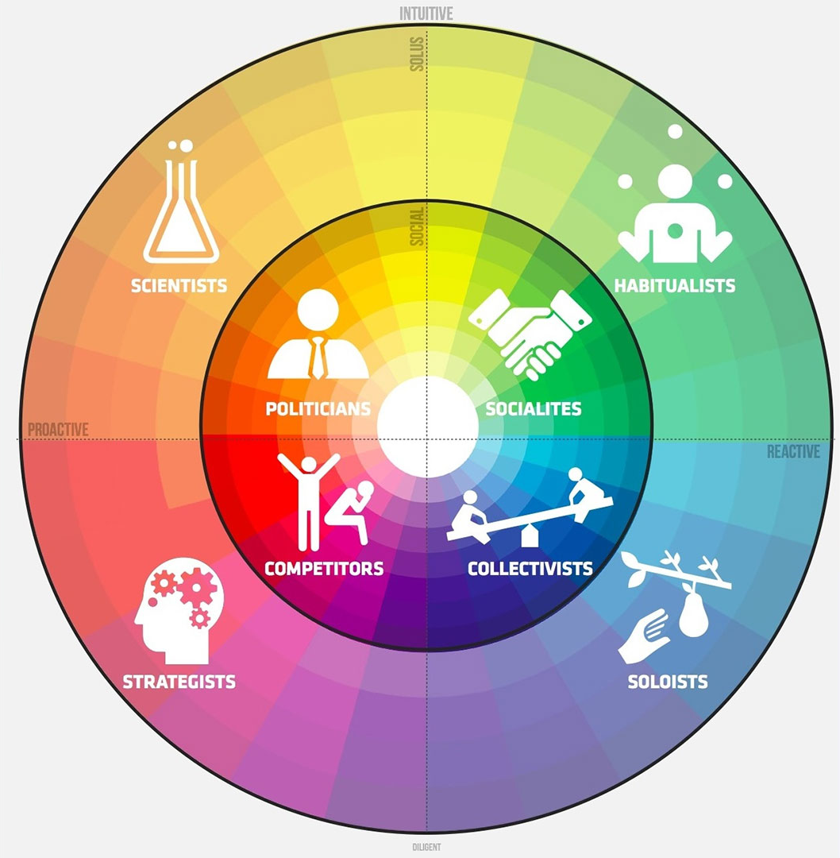
SaaS VAS segment wrapping
apply unsupervised learning to id patterns in the type, frequency and sequence of player actions
predict P(return, engage, invite, monetize) using supervised learning
Playnomics/Naked Communications
SaaS
VAS
PlayRM™ Messaging, individualised based on segmentation/scoring
PlayRM™ Marketplace, target players by their historical and predicted game behaviour
Source: Playnomics.com
Notes:
The most advanced packaging I’ve seen is the Playnomics services API which offers a dashboard that enables you define individualised targeted messaging to players, based on their analytically derived classification. This mapping is delivered dynamically.
What these services have in common, iSonamine, Game analytics, and Playnomics, is that they use an analytically derived classification to trigger individually relevant messaging-based interventions. These are at the level of the meta-game, rather than the game itself. A deeper integration isn’t an out of box experience.

Slide 34
Is home-made juice tastier?
useful open source tools readily available
  r + libraries
  WEKA
  Python + libraries
data volumes quickly lead practitioners to become interested in:
sampling
  but... ‘interesting’ events are usually long-tailed
efficiency
  e.g. simplex volume maximisation for convex hull constrained matrix factorisation in n
    Christian Thureau, IT University of Denmark, Data Mining in Games, http://vimeo.com/14390303
parallelisation
  Hadoop map/reduce in particular
  some ML algorithms more suitable for Map/Reduce style parallelisation than others
    KDD2011, Vijay Narayanan (Yahoo!) and Milind Bhandarkar (Greenplum Labs, EMC), Algorithms in modelling with Hadoop http://www.slideshare.net/hadoop/modeling-with-hadoop-kdd2011
Notes:
There are a lot of open source tools available for those willing to invest time and develop expertise. But the data volumes are an issue. You quickly get interested in sampling, efficiency, and parallelisation.

Slide 35
Problems
Boredom
Bafflement

Slide 36
Boredom
Notes:
Interesting, eh? Bet you can’t wait to find out which one is better.

Slide 37
And that data eventually
becomes a crutch
for every decision,
paralyzing the company
and preventing it
from making
any daring design
decisions.”
“When a company
is filled with engineers,
it turns to engineering to
solve problems.
Reduce each decision to
a simple logic problem.
Remove all subjectivity
and just look at the data..
http://stopdesign.com/archive/2009/03/20/goodbye-google.html
For a more recent and enthusiastic exposition of Google’s split testing approach, see ex-Googler Josh Wills’ take on it:
Experimenting at Scale, http://www.stanford.edu/group/mmds/slides2012/s-wills.pdf
and http://berkeleydatascience.files.wordpress.com/2011/03/20110301berkeley.pdf
Notes:
Google split test 41 shades of blue. How interesting is that? Might be better if it was grey.
There’s a famous rant from an ex-Googler about it.
In fact Google’s approach to experimenting at scale is more interesting than this suggests – in a geeky kind of way.

Slide 38

"when people start building their games to a spreadsheet its like putting cars through a wind tunnel-they all come out looking like bullets"
Matias Myllyrinne, CEO, Remedy Entertainment
http://www.gamesindustry.biz/articles/2012-09-05-remedy-entertainment-real-artists-ship
Notes:
But there’s a perception in the industry that tests make for boring designs. All cars look like bullets in a windtunnel.

Slide 39
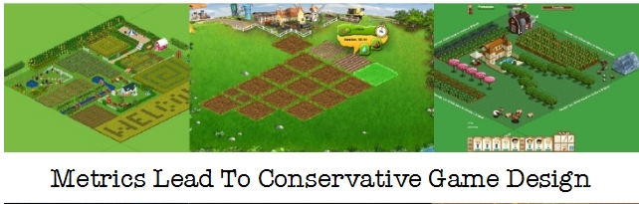

Tadgh Kelly
http://www.slideshare.net/tadhgk/the-four-lenses-of-game-making-and-social-games
http://www.whatgamesare.com/2011/12/the-four-lenses-of-game-making.html
Notes:
And all farm games converge to look like the ur-farm game. Personally I think this more about fast-following than about metrics. But it’s how people think about it.

Slide 40

Bafflement
?
?
Notes:
Bafflement’s another problem. There are different types of bafflement.

Slide 41
We don’t understand what’s going on. All we know is we’re going to keep running these experiments to try and understand better what it is that our customers are telling us. And there are clearly things that we don’t understand because a simple analysis ...implies very contradictory yet reproducible results. So clearly there are things that we don’t understand, and we’re trying to develop theories for them. It’s... an exciting time but also a very troubling time.
June 23 2012 Value hires Greek economist in residence to look at shared currency issues.
Gabe Newell, Founder, Valve
Oct 23 2011
http://www.geekwire.com/2011/experiments-video-game-economics-valves-gabe-newell/
Notes:
There’s expert bafflement. Let’s take Valve - a very successful developer and publisher. They’re full of smart people. They do experiments. They hired an economist and a psychologist. And they are still baffled.

Slide 42


Designer = bean-counter, or
Bean-COUNTER
Designer?
Notes:
Then there’s other kinds of bafflement. This way of designing, using heavy feedback, is a new competence. And all the skill sets involved in using to to best advantage don’t necessarily come in the same package.

Slide 43

Product manager = data-miner?
As someone who wants to analyse our games, but with no detailed knowledge of how to query databases or program, I need the easy-to-use solutions with the pretty presentation, and I need our web guys to set them up. I suspect a lot of companies who are new to analytics will be the same - the staff who need to analyse are not qualified to deep data mine themselves.
Matt Falcus
Product Manager
Team 17 Software
Notes:
The usual organisational fix here is to make the product manager responsible for loving numbers. Product manager aren’t usually data miners, or data scientists.

Slide 44
Industry context
4th producer globally
£1b to GDP
~4000 people
~500 companies
Skillset (2008)
9,000 developers
down 11% from 2008
TIGA (2011)
http://www.creativeskillset.org/uploads/pdf/asset_16891.pdf, 19/9/2012
http://www.tiga.org/about-us-and-uk-games/uk-video-games-industry, 19/9/2012
Notes:
But not every games company is well placed for using specialist expertise. More than half the games companies in UK have less than 20 people. And most people who work in a game company work in a company with less than 50 people in it.

Slide 45
Discovery-driven
not data-driven
Notes:
The approach I’ve been developing for this type of work – and practicing on my clients - I call being discovery-driven. I’ve found that it helps with engagement and mind-set, for designers.

Slide 46
How to be discovery-driven
focus on Questions that
seek Answers that
are important
are interesting
are open, not closed
  although may need to be operationalised as yes/no
connect to concerns and curiosities about
  your design, and
  how people use it, and
  how it will evolve
emerge from answers
are actionable
  but also
lead to more questions

Slide 47
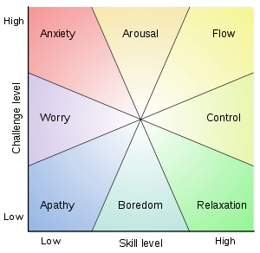
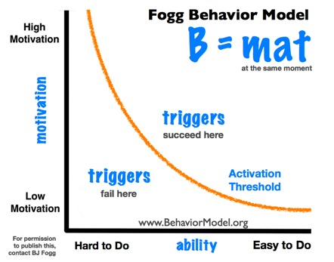


There’s no shortage of theories
Depth
psychology
Csikszentmihalyi Flow model
Behavioural
economics
+ “personality”
Image of Sigmund Freud, Library of Congress, Prints & Photographs Division, Sigmund Freud Collection, LC-DIG-ppmsca-23761.
Image of Amos Tversky, Stanford News Network, http://psycnet.apa.org/journals/amp/58/9/images/amp_58_9_723_fig1a.jpg
Fogg Behaviour model reproduced with permission from B J Fogg http://www.behaviormodel.org/index_files/pasted-graphic.jpg
Csikszentmihalyi Flow model, http://upload.wikimedia.org/wikipedia/commons/thumb/f/f6/Challenge_vs_skill.svg/300px-Challenge_vs_skill.svg.png
Notes:
There is an embarrassment of theories about people that you can plunder in service of ideas for design variation and investigation.
Psychologists are way worse than economists.

Slide 48
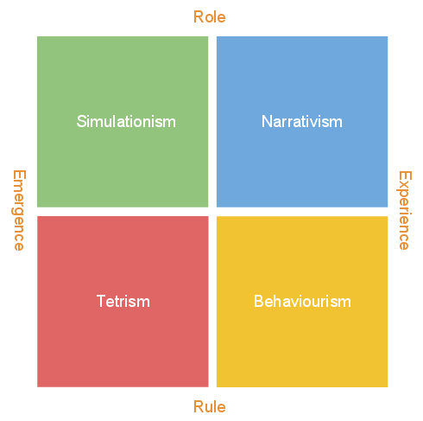
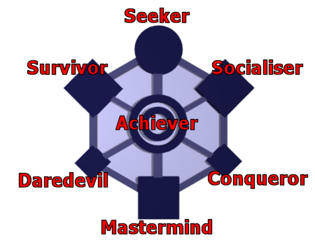
Games have lots, too
Game types
Player types
Chris Bateman
brainhex.com
Tadgh Kelly
http://www.whatgamesare.com/2011/12/the-four-lenses-of-game-making.html
Notes:
And there are lots of game-specific ideas, too. It’s interesting to think about how these typologies relate to analytically derived ones. A story for another day....

Slide 49
Core mechanic: design quest
A question bigger than itself
Change
Think
Look
Notes:
What you want is to ask questions that are bigger than themselves. Ones whose answers help forge an inference path to other questions with wider scope.
This means theoretically motivated feature abstraction, as well as feature extraction.

Slide 50
There’s lots to do!
...and it’s very engaging

